Slide 1

Project Title – Healthcare Analytics for Doctor Visits_TIRTC
Name :- Mansi

Slide 2

PROBLEM STATEMENT
Healthcare data contains valuable information about patients’ illness, hospital visits, income, health insurance coverage, and daily activity limitations. However, analyzing these factors manually can make it difficult to identify meaningful patterns and relationships.
The objective of this project, Doctor Visits Analytics, is to analyze healthcare data using Python to understand the factors associated with hospital visits. The project explores illness distribution, gender differences, income levels, health insurance coverage, and the relationship between income and hospital visits. It also examines reduced activity due to illness and checks the dataset for missing values and correlations between numerical variables.
By using data analysis and visualization techniques, this project aims to transform raw healthcare data into meaningful insights that can support better understanding of healthcare utilization and patient-related patterns.

Slide 3
Project Description
The Healthcare Analytics for Doctor Visit project focuses on analyzing healthcare data to understand patterns in doctor visits and the factors that influence patients’ healthcare utilization.
The project involves collecting, cleaning, and analyzing healthcare data using data analysis tools. It explores factors such as age, income, health conditions, insurance coverage, and activity limitations to identify trends and relationships associated with doctor visits.
The analysis results are presented through visualizations and meaningful insights, making the data easier to understand and helping support data-driven decisions in healthcare.

Slide 4

WHO ARE THE END USERS?
The Healthcare Analytics for Doctor Visit project can be useful for:
Healthcare Professionals: To understand patterns in patients’ doctor visits and health conditions.
Hospitals and Clinics: To analyze healthcare utilization trends and patient demographics.
Healthcare Researchers: To study relationships between health, income, insurance coverage, and doctor visits.
Government and Policymakers: To understand healthcare access and support evidence-based planning.
Data Analysts: To explore healthcare datasets and generate meaningful insights through data visualization.

Slide 5

Technology Used
1. Python - Used for data analysis, data manipulation, and performing calculations on healthcare data.
2. Pandas - Used to load, organize, clean, and analyze the dataset.
3. Matplotlib - Used to create graphs and visual representations of the analysis results.
4. Seaborn - Used to create statistical visualizations, including box plots, scatter plots, and correlation heatmaps.
5. Jupyter Notebook - Used to write and execute Python code, analyze the dataset, and display results.
6. NumPy - Used for numerical operations and data processing.

Slide 6
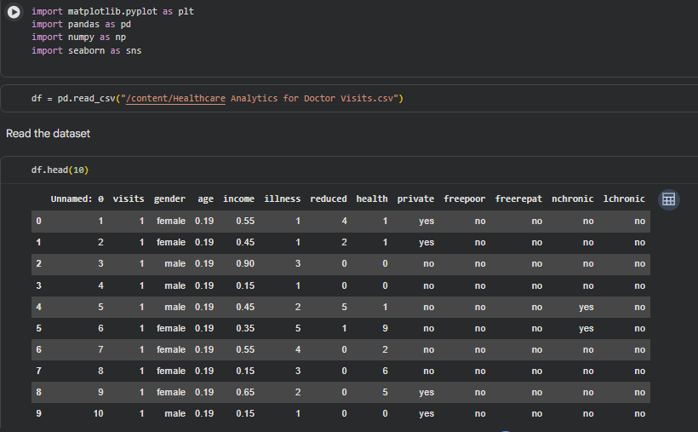
READING THE DATASET
https://github.com/mansi-analytics

Slide 7
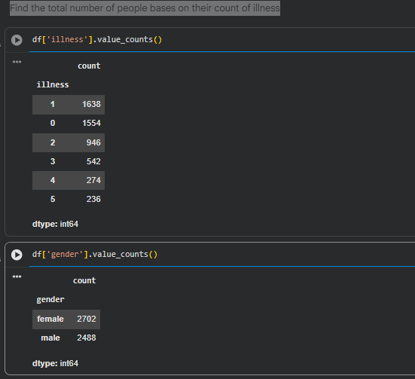
Find the total number of people bases on their count of illness
Key Findings :-
Illness count shows the number of people in each illness category.
The distribution highlights how illness counts vary among people.
Overall, the analysis summarizes the frequency of illnesses in the dataset.
https://github.com/mansi-analytics

Slide 8
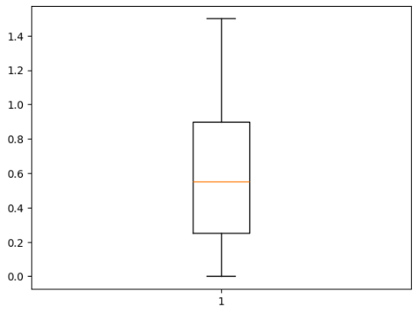
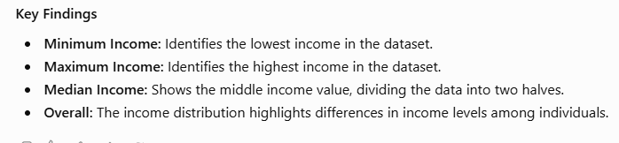
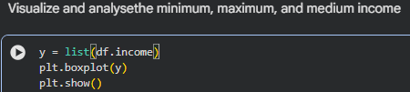
Visualize and analyse the minimum, maximum, and medium income
https://github.com/mansi-analytics

Slide 9
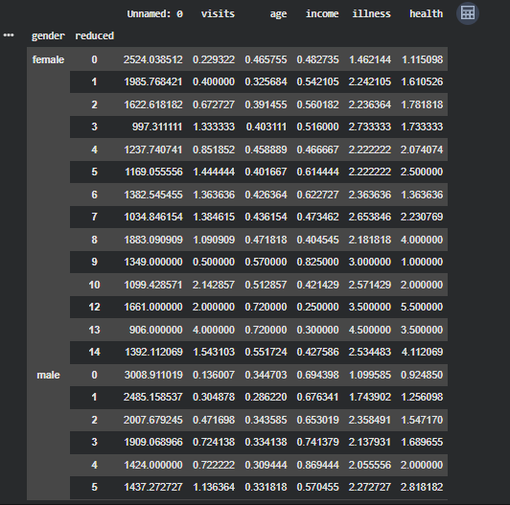
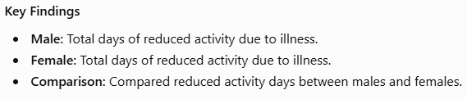

Find out the number of days of reduced activityof male and female seperatly due to illness
https://github.com/mansi-analytics

Slide 10
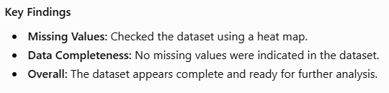
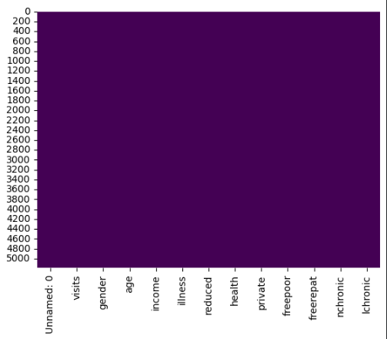

visualize is there any missing values in the dataset based on a heat map
https://github.com/mansi-analytics

Slide 11
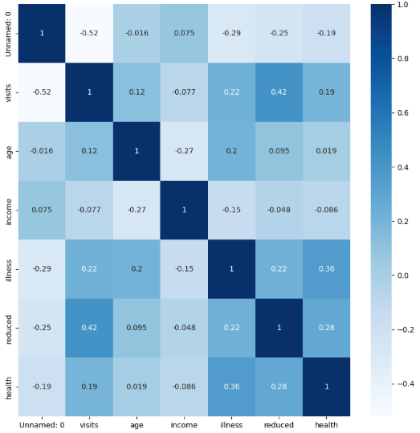
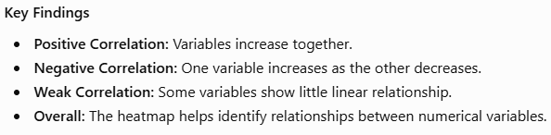

Find out the correlation between variables in the given dataset
https://github.com/mansi-analytics

Slide 12
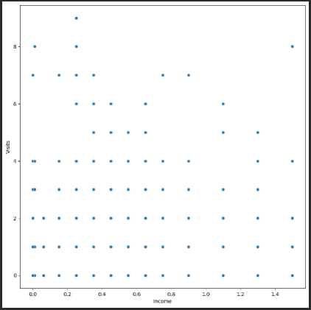
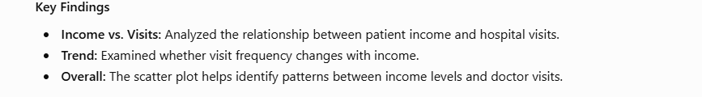
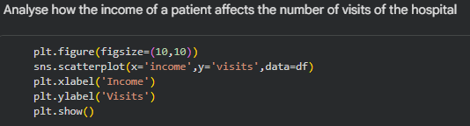
Analyze how the income of a patient affects the number of visits of the hospital
https://github.com/mansi-analytics

Slide 13
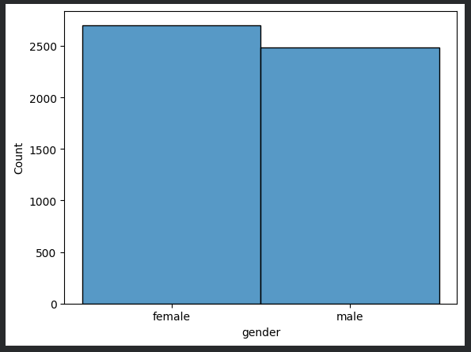
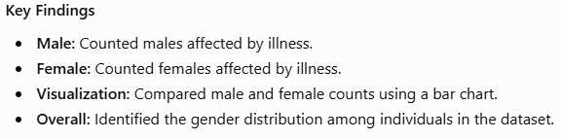
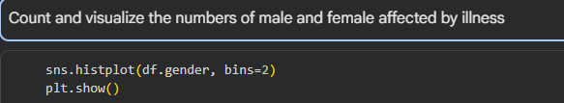
Count and visualize the numbers of male and female affected by illness
https://github.com/mansi-analytics

Slide 14
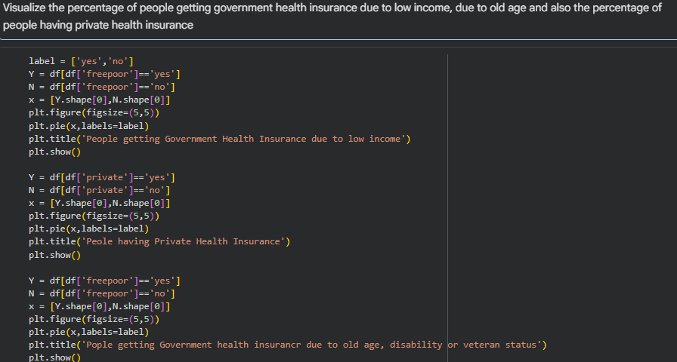
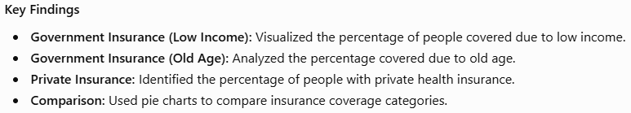
Visualize the percentage of people getting government health insurance due to low income, due to old age and also the percentage of people having private health insurance
https://github.com/mansi-analytics

Slide 15
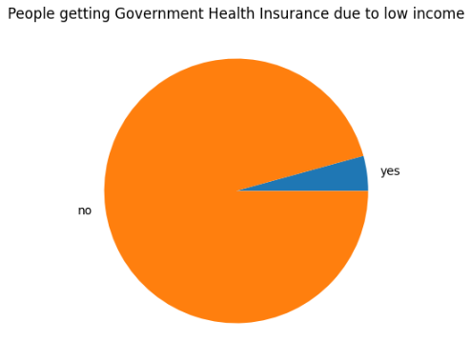
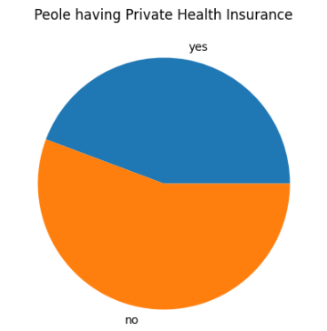
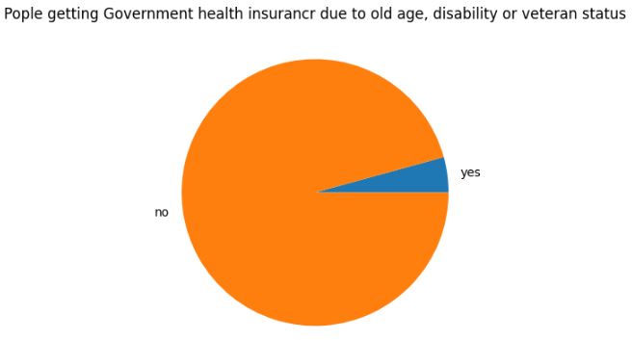
https://github.com/mansi-analytics

Slide 16
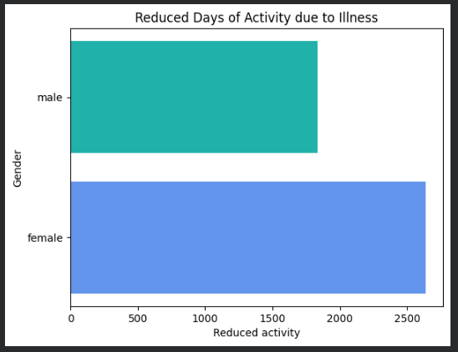
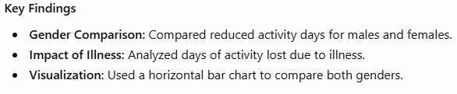
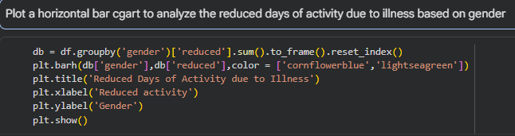
Plot a horizontal bar cgart to analyze the reduced days of activity due to illness based on gender
https://github.com/mansi-analytics

Slide 17

Healthcare Analytics for Doctor Visits_TIRTC
.
.

